Slide 1
Skin Permeation

Slide 2
Data Preparation
We replaced null values in HY column ‘Kier 3’ with 0.
We dropped column M ‘MVh’.
For Properties we dropped 'No', 'Compound', 'SMILES', 'CAS No',
'MVh', 'Skin Integrity testk', 'Skin Selection criteria', 'logkpl’.
For Descriptors we dropped 'SMILES.1', 'Reference’.
For set column we used one hot encoding

Slide 3
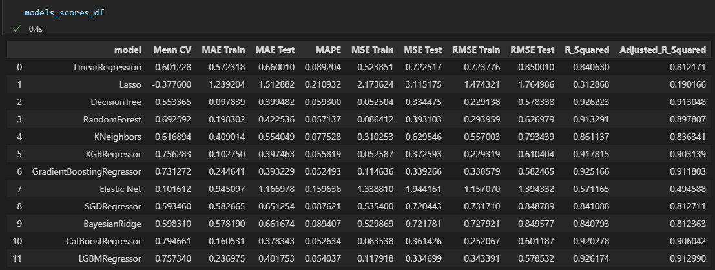
Properties

Slide 4
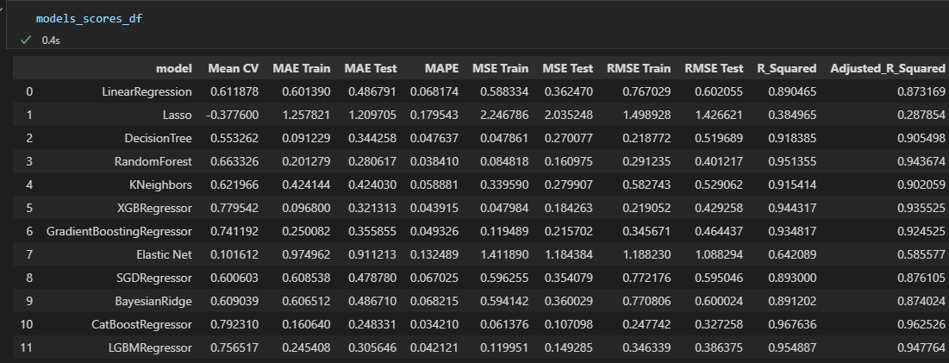
Properties

Slide 5
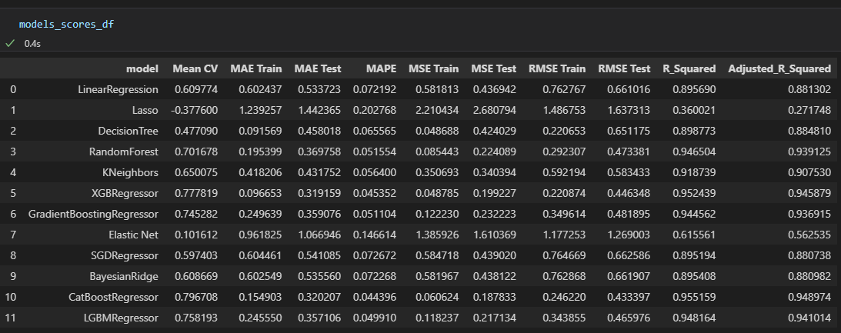
Properties

Slide 6
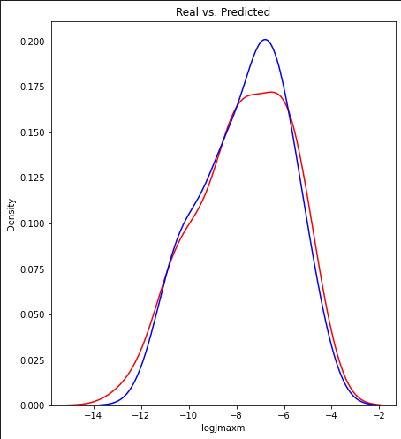
Properties

Slide 7
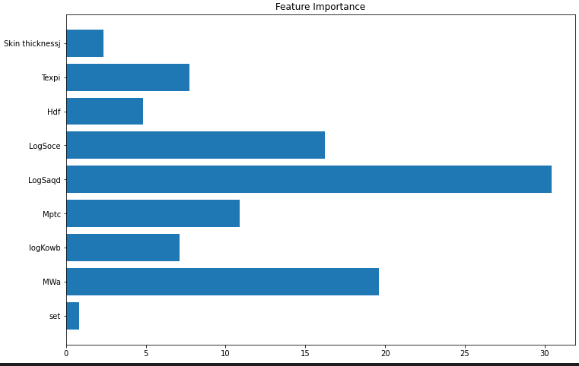
Properties

Slide 8
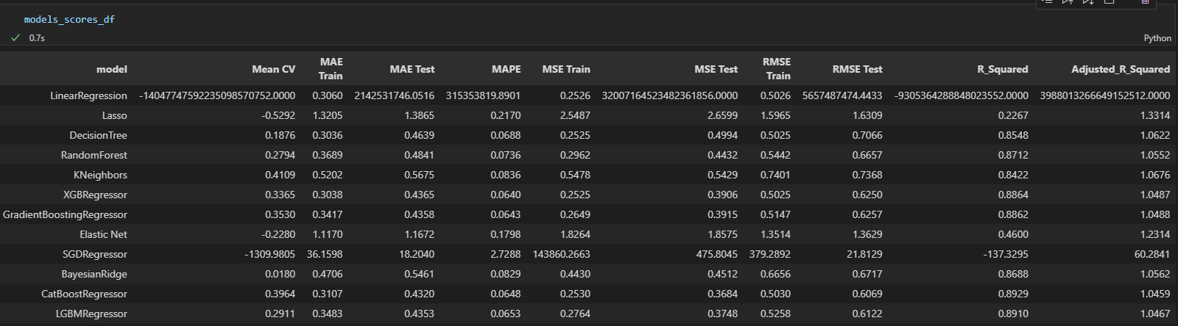
Descriptors

Slide 9
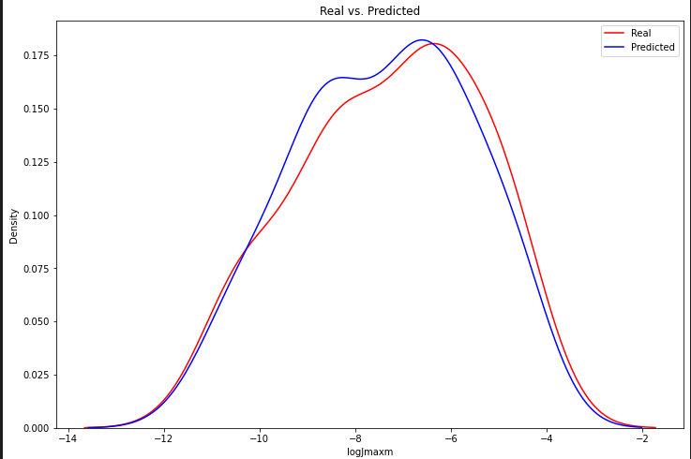
Descriptors

Slide 10
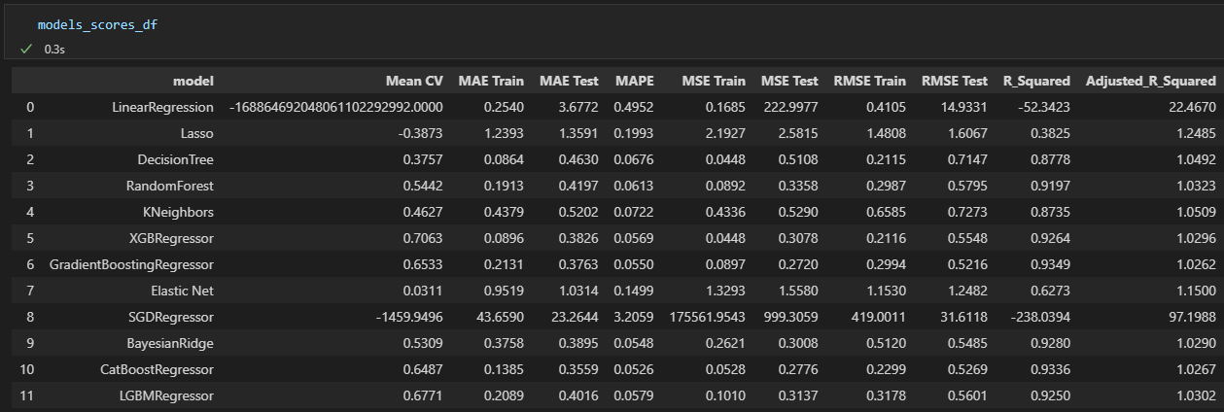
Properties & Descriptors

Slide 11
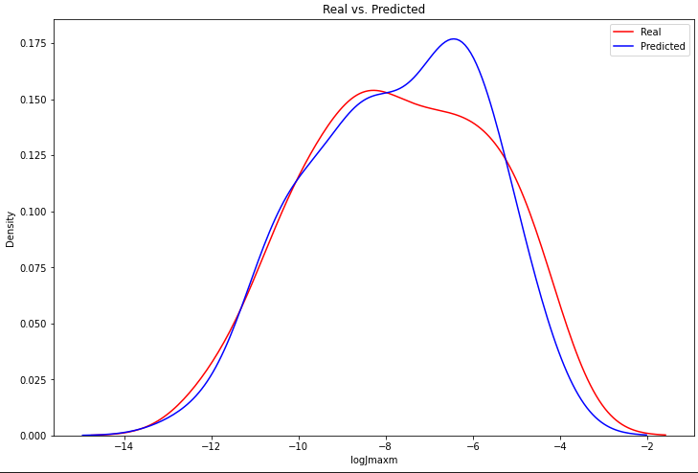
Properties & Descriptors

Slide 12
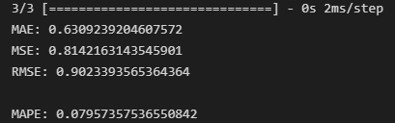
ANN

